Slide 1

Anomaly Detection Algorithms
→ Mahesh Surisetty

Slide 2
Learning Objectives:
1. Demonstrate how to detect Anomalies on the Time series data and how to find the patterns in the data to detect the anomalies using the prophet algorithm hands on practical with Jupyter notebook.
2. Demonstrate how to detect Anomalies on the Non-Time series data (Supervised & Unsupervised) algorithms will illustrate examples in each case study hands on end to end with Jupyter notebooks.
3. Understanding how Graph Neural Networks and how it can be used in Anomaly detection with detailed case study and practical with Jupyter notebook.

Slide 3

Session 1 :
Attendees will be walked through how to solve Anomaly detection problem use cases help in solving complex Outliers in the data and which algorithms are best suited as per the data (Time series & Non Time series) and detailed explanation of how to use historical data to find the Anomalies using the Supervised algorithm and how to predict the anomalies if there is no historical track of anomaly data and still need to identify the anomalies in the data using the Unsupervised algorithms.
1. Time Series Anomaly Detection (Theory & Practical) explanation with use case.
2. Non Time series Supervised Anomaly Detection (Theory & Practical) explanation with explanation using the Cluster & Non Cluster algorithms.
Github : https://github.com/mahesh9143/AnomalyDetection.git

Slide 4
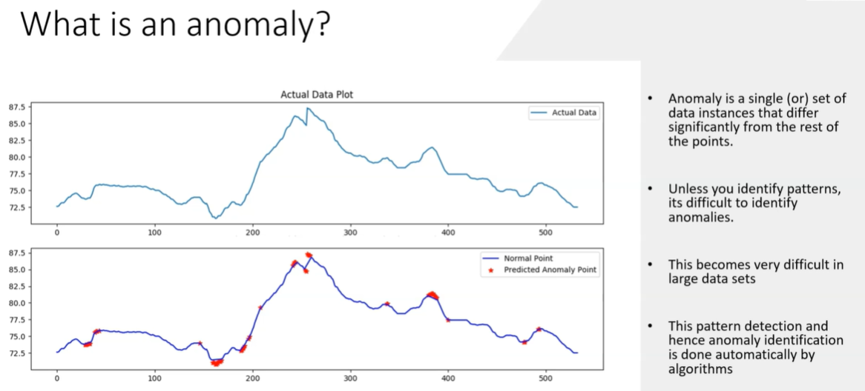

Slide 5
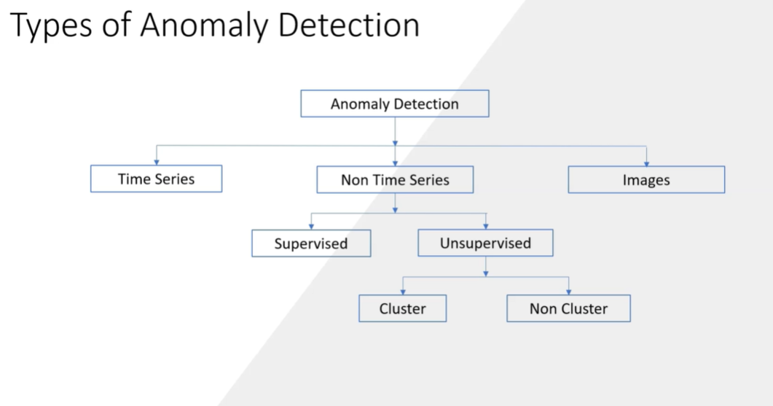

Slide 6
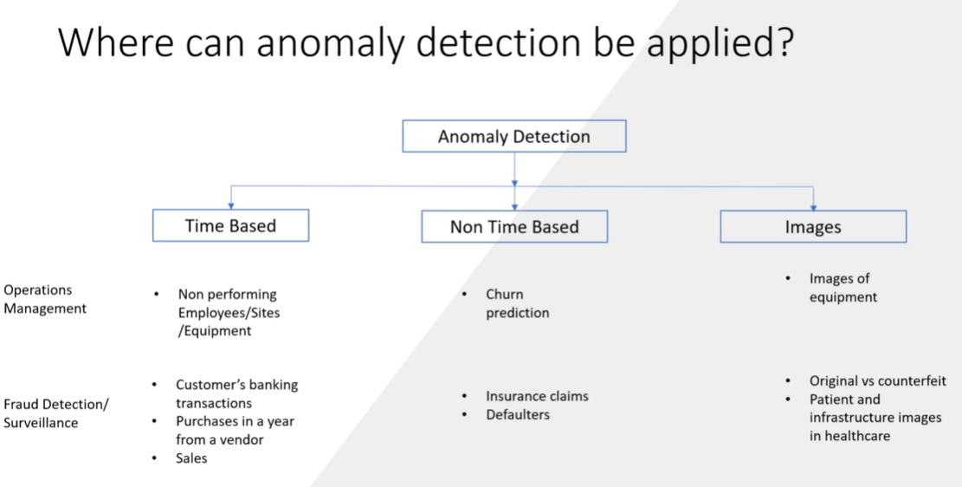

Slide 7
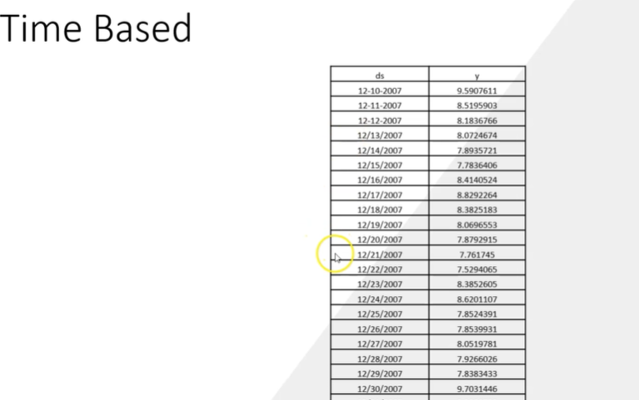

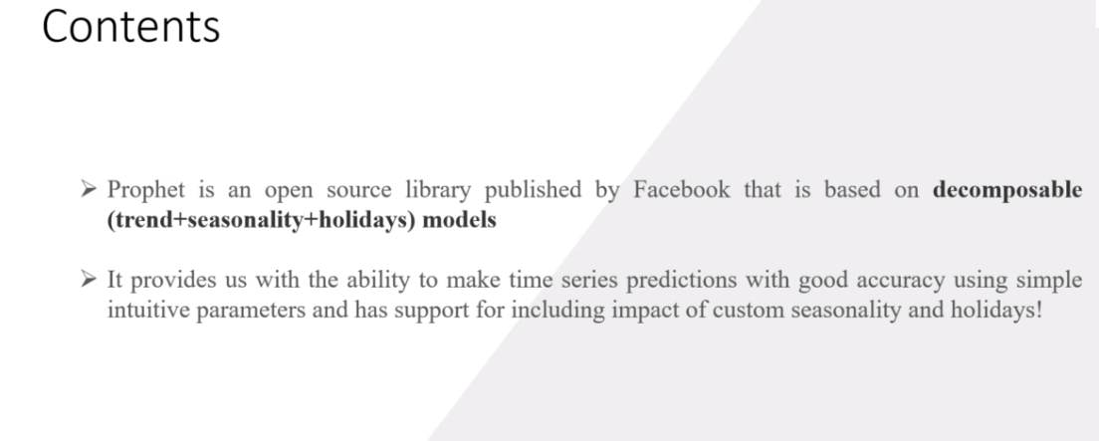

Slide 8
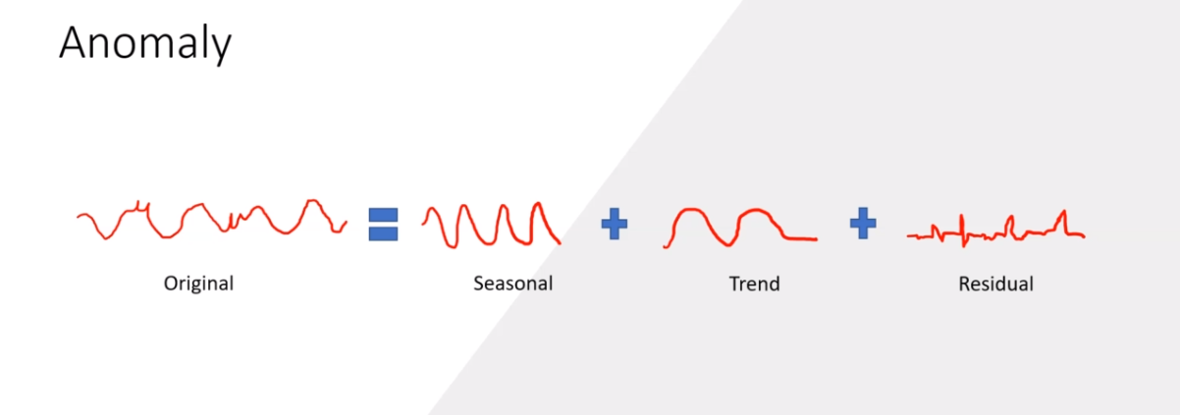

Slide 9
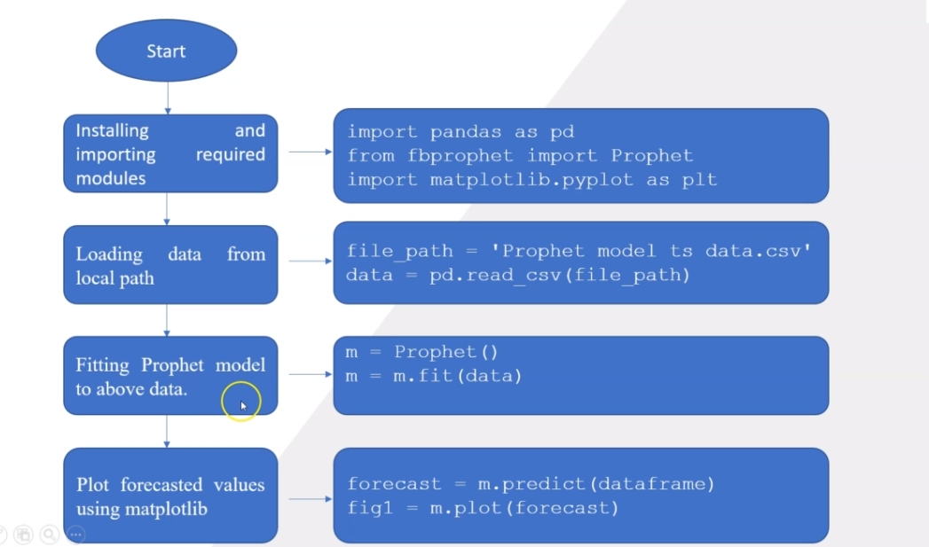

Slide 10
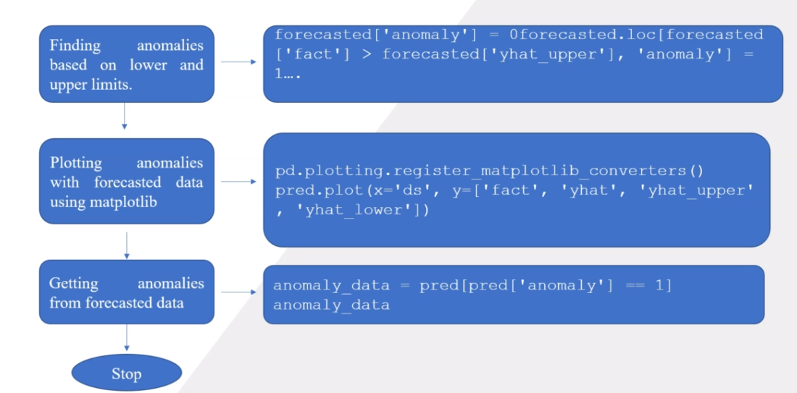

Slide 11
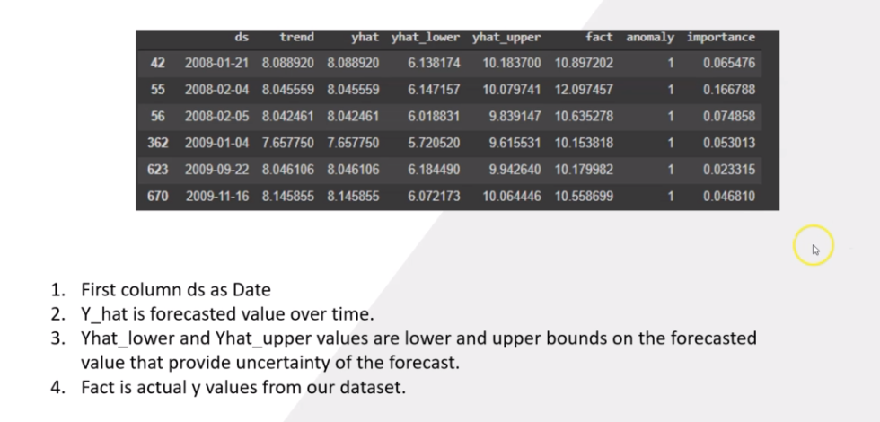

Slide 12
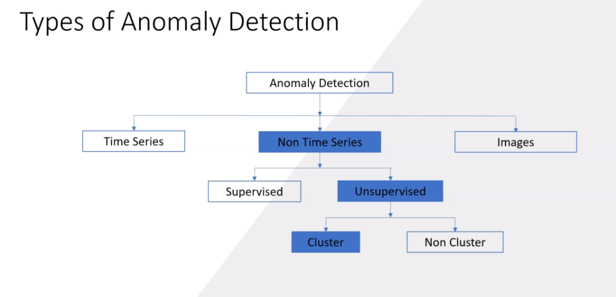
Unsupervised Cluster Anomaly Detection:

Slide 13
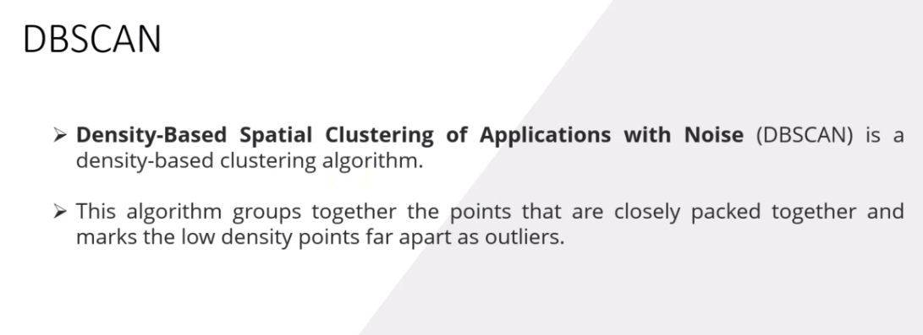

Slide 14
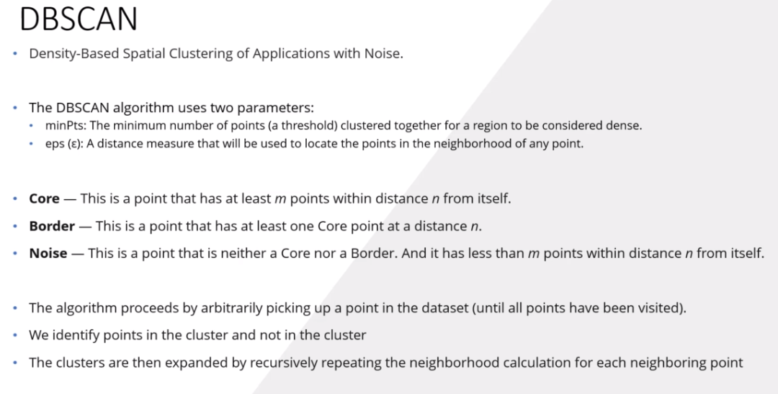

Slide 15
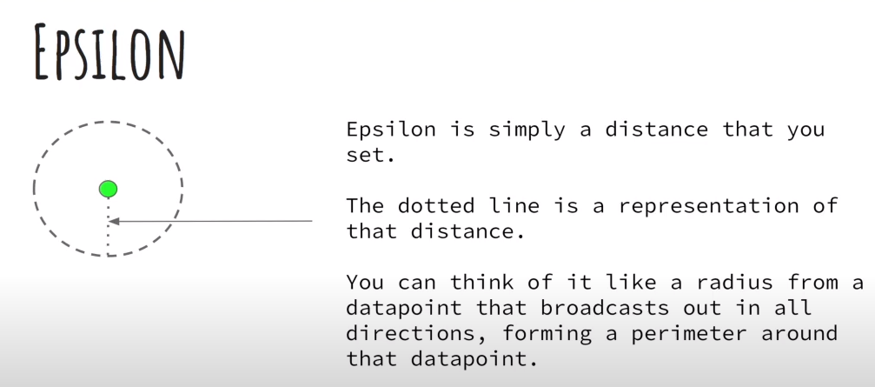
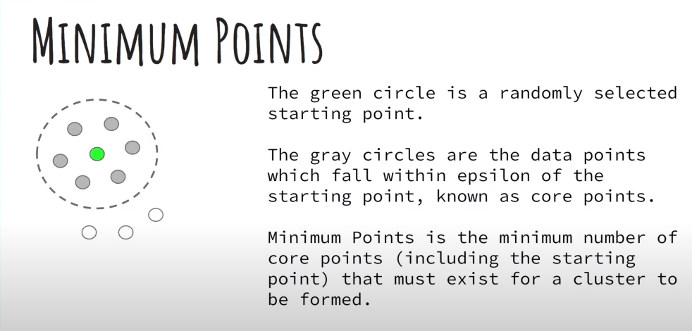

Slide 16
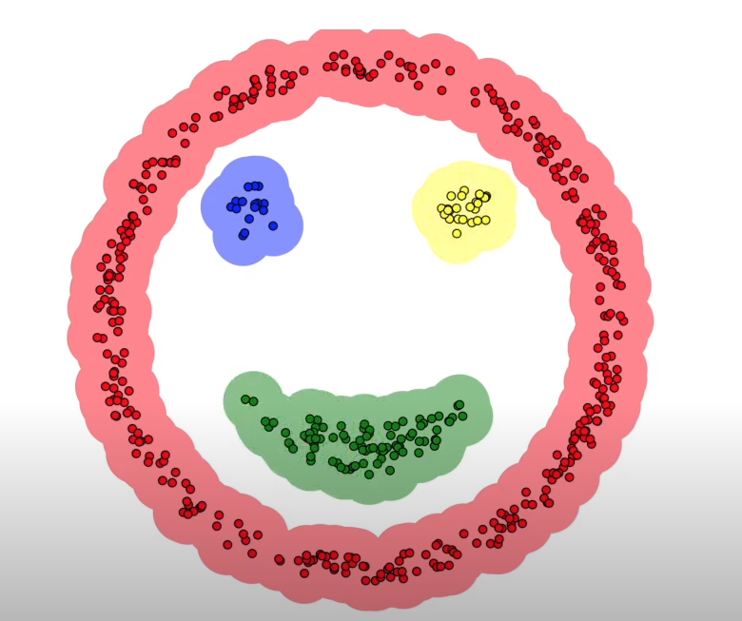
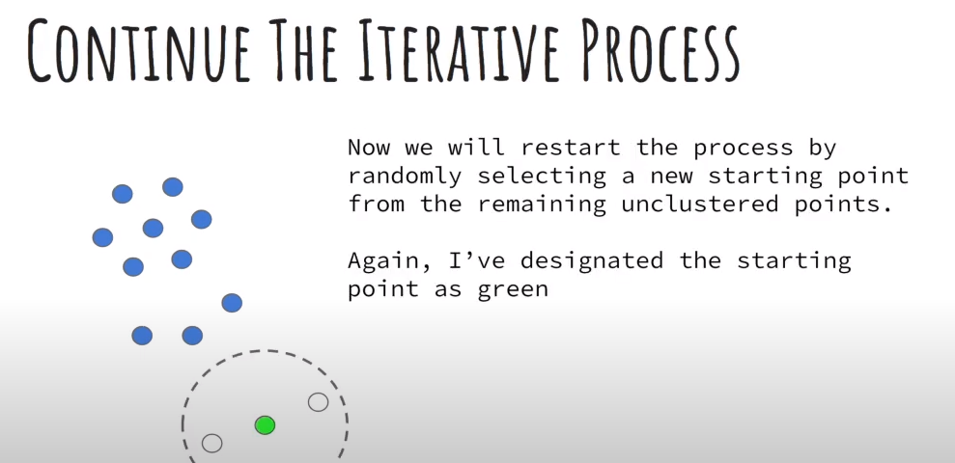

Slide 17
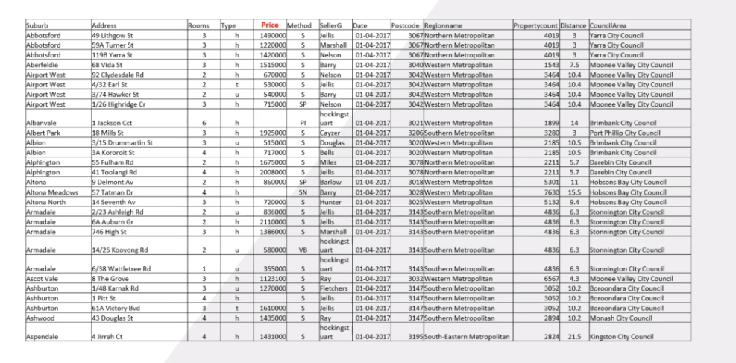

Slide 18
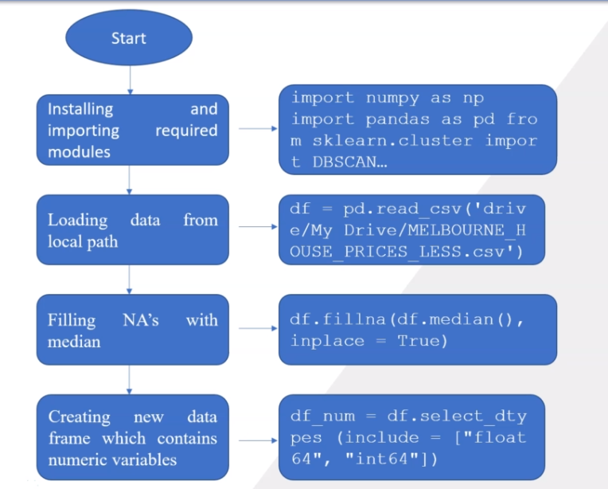

Slide 19
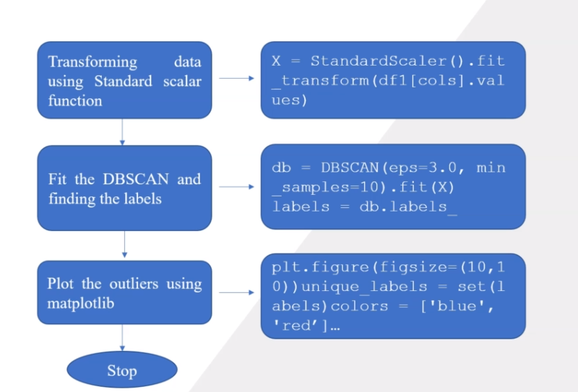

Slide 20
We must use the Standard Scaling in the Anomaly Detection because it allows the Anomaly data points in the distribution to be identified.
Otherwise if the use the
Robust Scaler then the interquartile range will take precedence and the Anomaly’s will be removed automatically.
Minmax Scaler will shrink the values to the narrow extent 0 to 1 and it will be difficult to find the anomaly’s.

Slide 21
The Session 1 End’s here. Any Queries ?

